Slide 1
The Future is NOW… Did You Miss It?
California Career Development Association
2018 Fall Regional Conference
“The Changing Landscape of the World of Work”
Dr. Terri Horton MBA, MA, SHRM-CP, PHR, HCS, SWP
Workforce Futurist
FuturePath, LLC

Slide 3
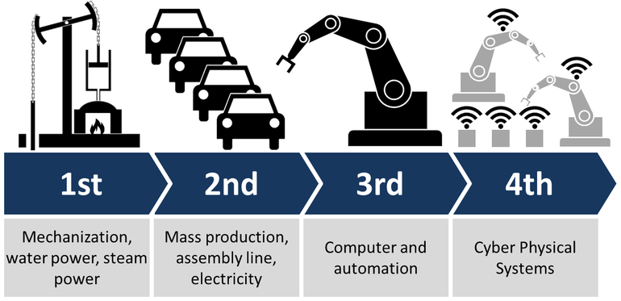
Industry 4.0: The 4th Industrial Revolution
Welcome to the 4th Industrial Revolution
IOT brings physical, technological, virtual reality, 3D printing and robotics

Slide 4
Industry 4.0 The Future of Work
Human talent will work alongside AI, machine learning, natural language processing—or anything that can replace tasks in a business process and make them quicker, more accurate, and less costly – PWC, 2018

Slide 5
Industry 4.0 Reimaging Jobs
“Large numbers of people will have to invent their own jobs, based on new types of work created by organizations that leverage digital markets and platforms.” MIT Sloan, 2018

Slide 6
Industry 4.0 Reimaging Jobs
As organizations flatten, condense departments, combine roles, automate processes, use AI to remove tasks, jobs are reimagined to add more value
Sales Account Executive
Strategy, VR, Immersive Simulations, Gamification, Design Thinking

Slide 7
Industry 4.0 New Career Models
Flatter Organizations = Less Mobility
Career Lattice VS. Career Ladder

Slide 8
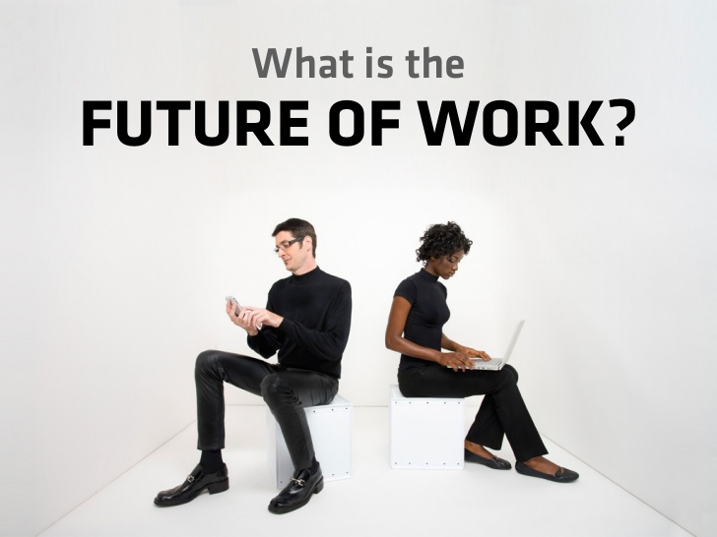
“People need to reinvent themselves continuously Workers who succeed are “chameleons”—they can adapt their skillsets to stay relevant” – MIT Sloan, 2018

Slide 9
Industry 4.0 New Opportunities
AI is driving business strategy and innovation
AI gives you “super powers” to do work more effectively
Thrive in the spaces between people and machines

Slide 10
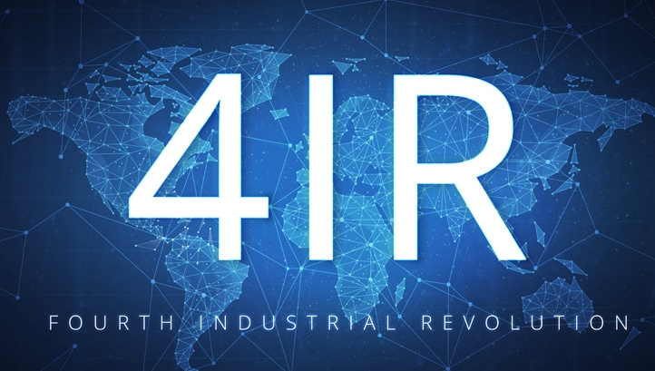
Industry 4.0 The Future is Now…You Did Not Miss It!

Slide 11
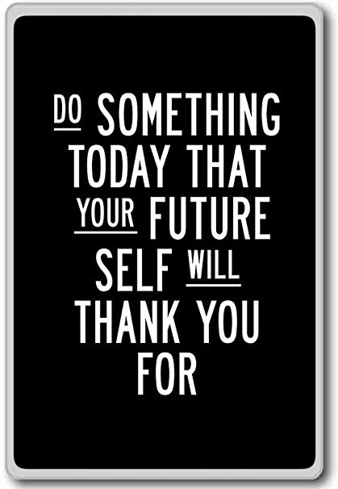
Thank You
Dr. Terri Horton MBA, MA, SHRM-CP, HCS, SWP
Workforce Futurist | Corporate Trainer | Keynote Speaker
Download Free Infographic
“5 Tips to Future-Proof Your Brand in The AI Economy”
www.terrilhorton.com/5Tips
DrTerriHorton@gmail.com

